Slide 1
World Green House Gases (GHG) Emission Visualization
BARIKI G ELILAKI

Slide 2
INTRODUCTION
My career aspirations in data science is to develop various software to help people to make better business decision.
In this Shiny project, I choose to visualize Greenhouse gases emissions which is a great cause of global warming.

Slide 3
WHY THIS PROJECT
Greenhouse gases surround the Earth like a blanket. As we use burn more coal, natural gas, and oil, the blanket becomes excessively thick, dense, and less likely to allow heat to escape. Heat gets trapped inside the blanket of greenhouse gases and the Earth becomes too warm.

Slide 4
DATA SOURCE
1. Kaggle.com
2. The Global Social Change Research Project, The US Government
https://www.kaggle.com/srikantsahu/co2-and-ghg-emission-data/download
http://www.statvision.com/webinars/Countries%20of%20the%20world.xls

Slide 5
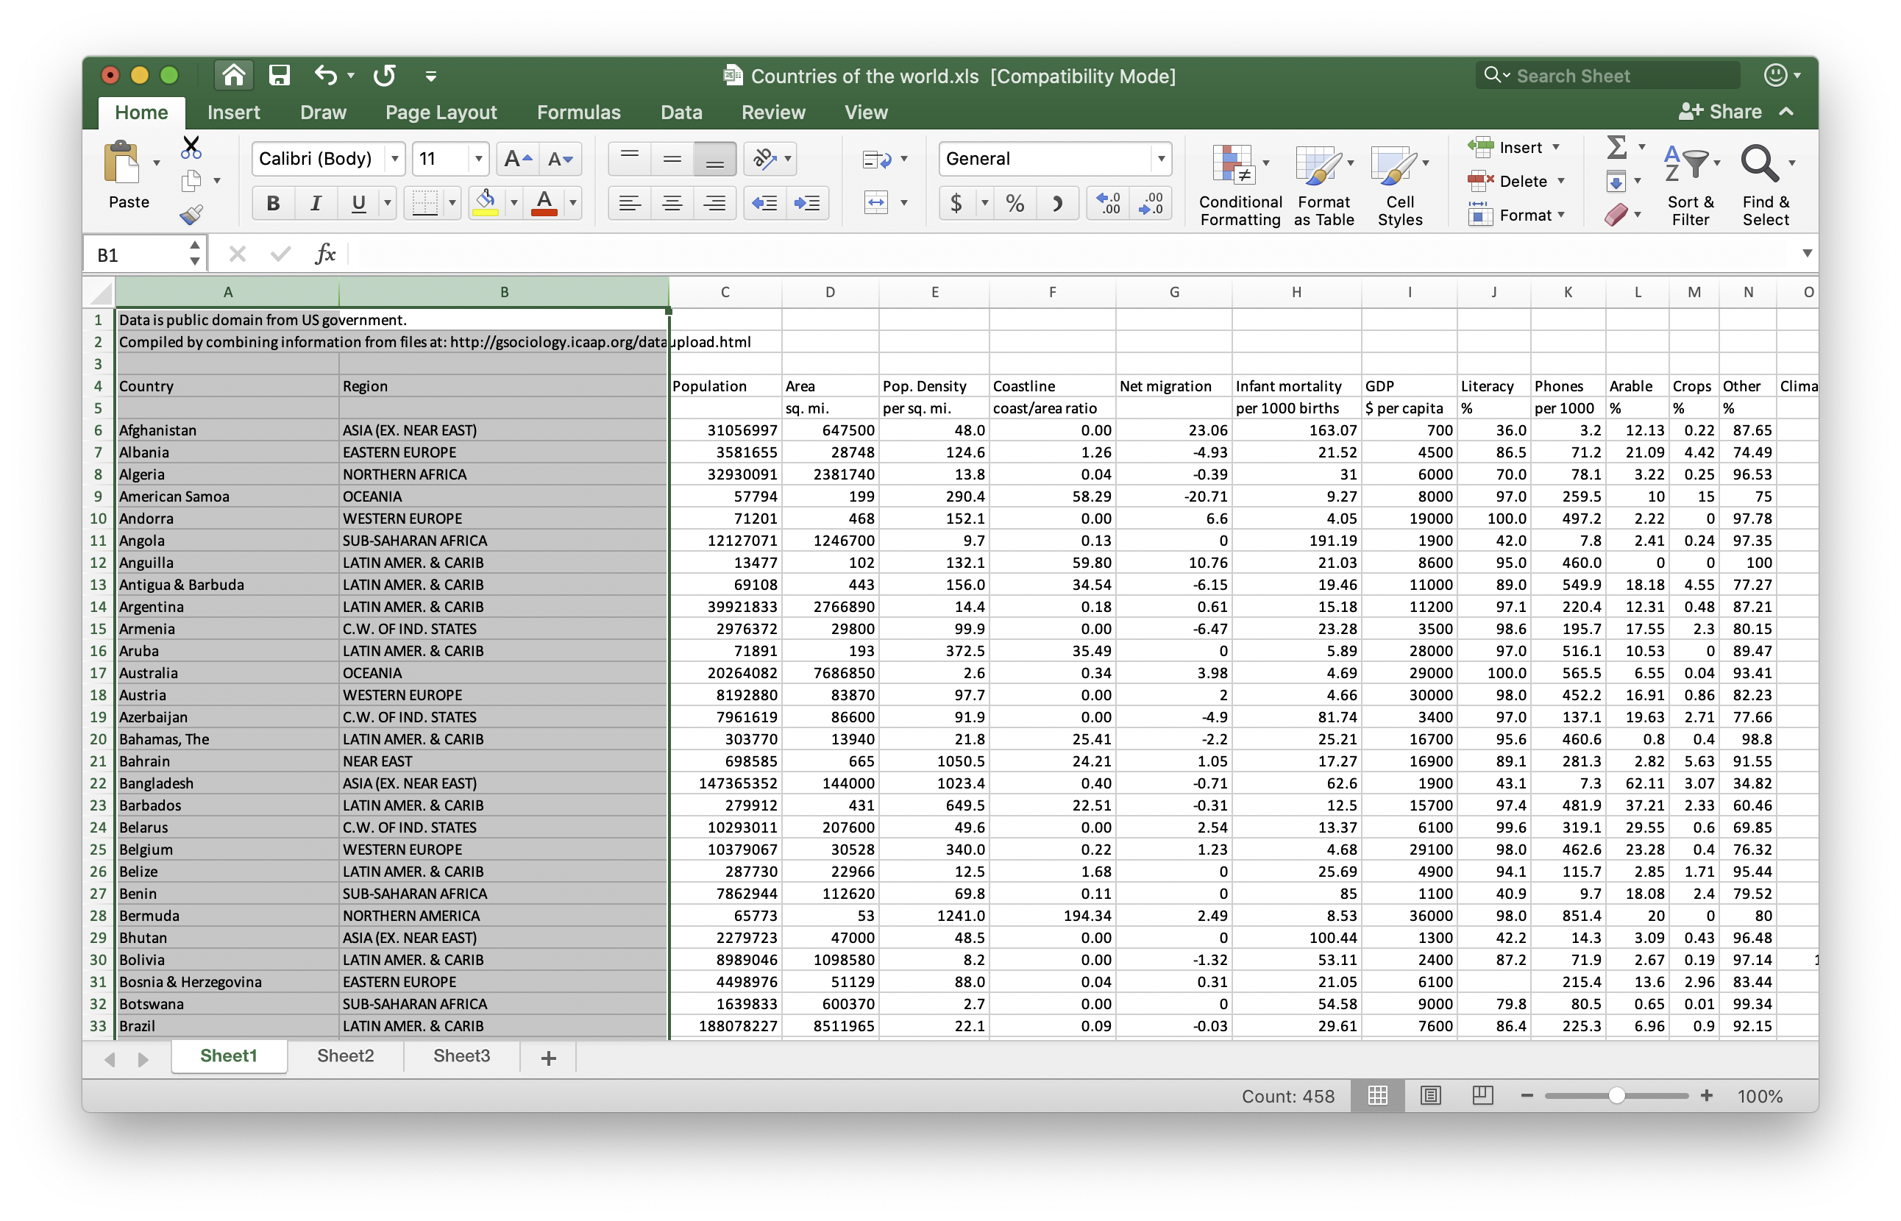
DATA PREVIEW
From Global Social Change Research Project, The US Government

Slide 6
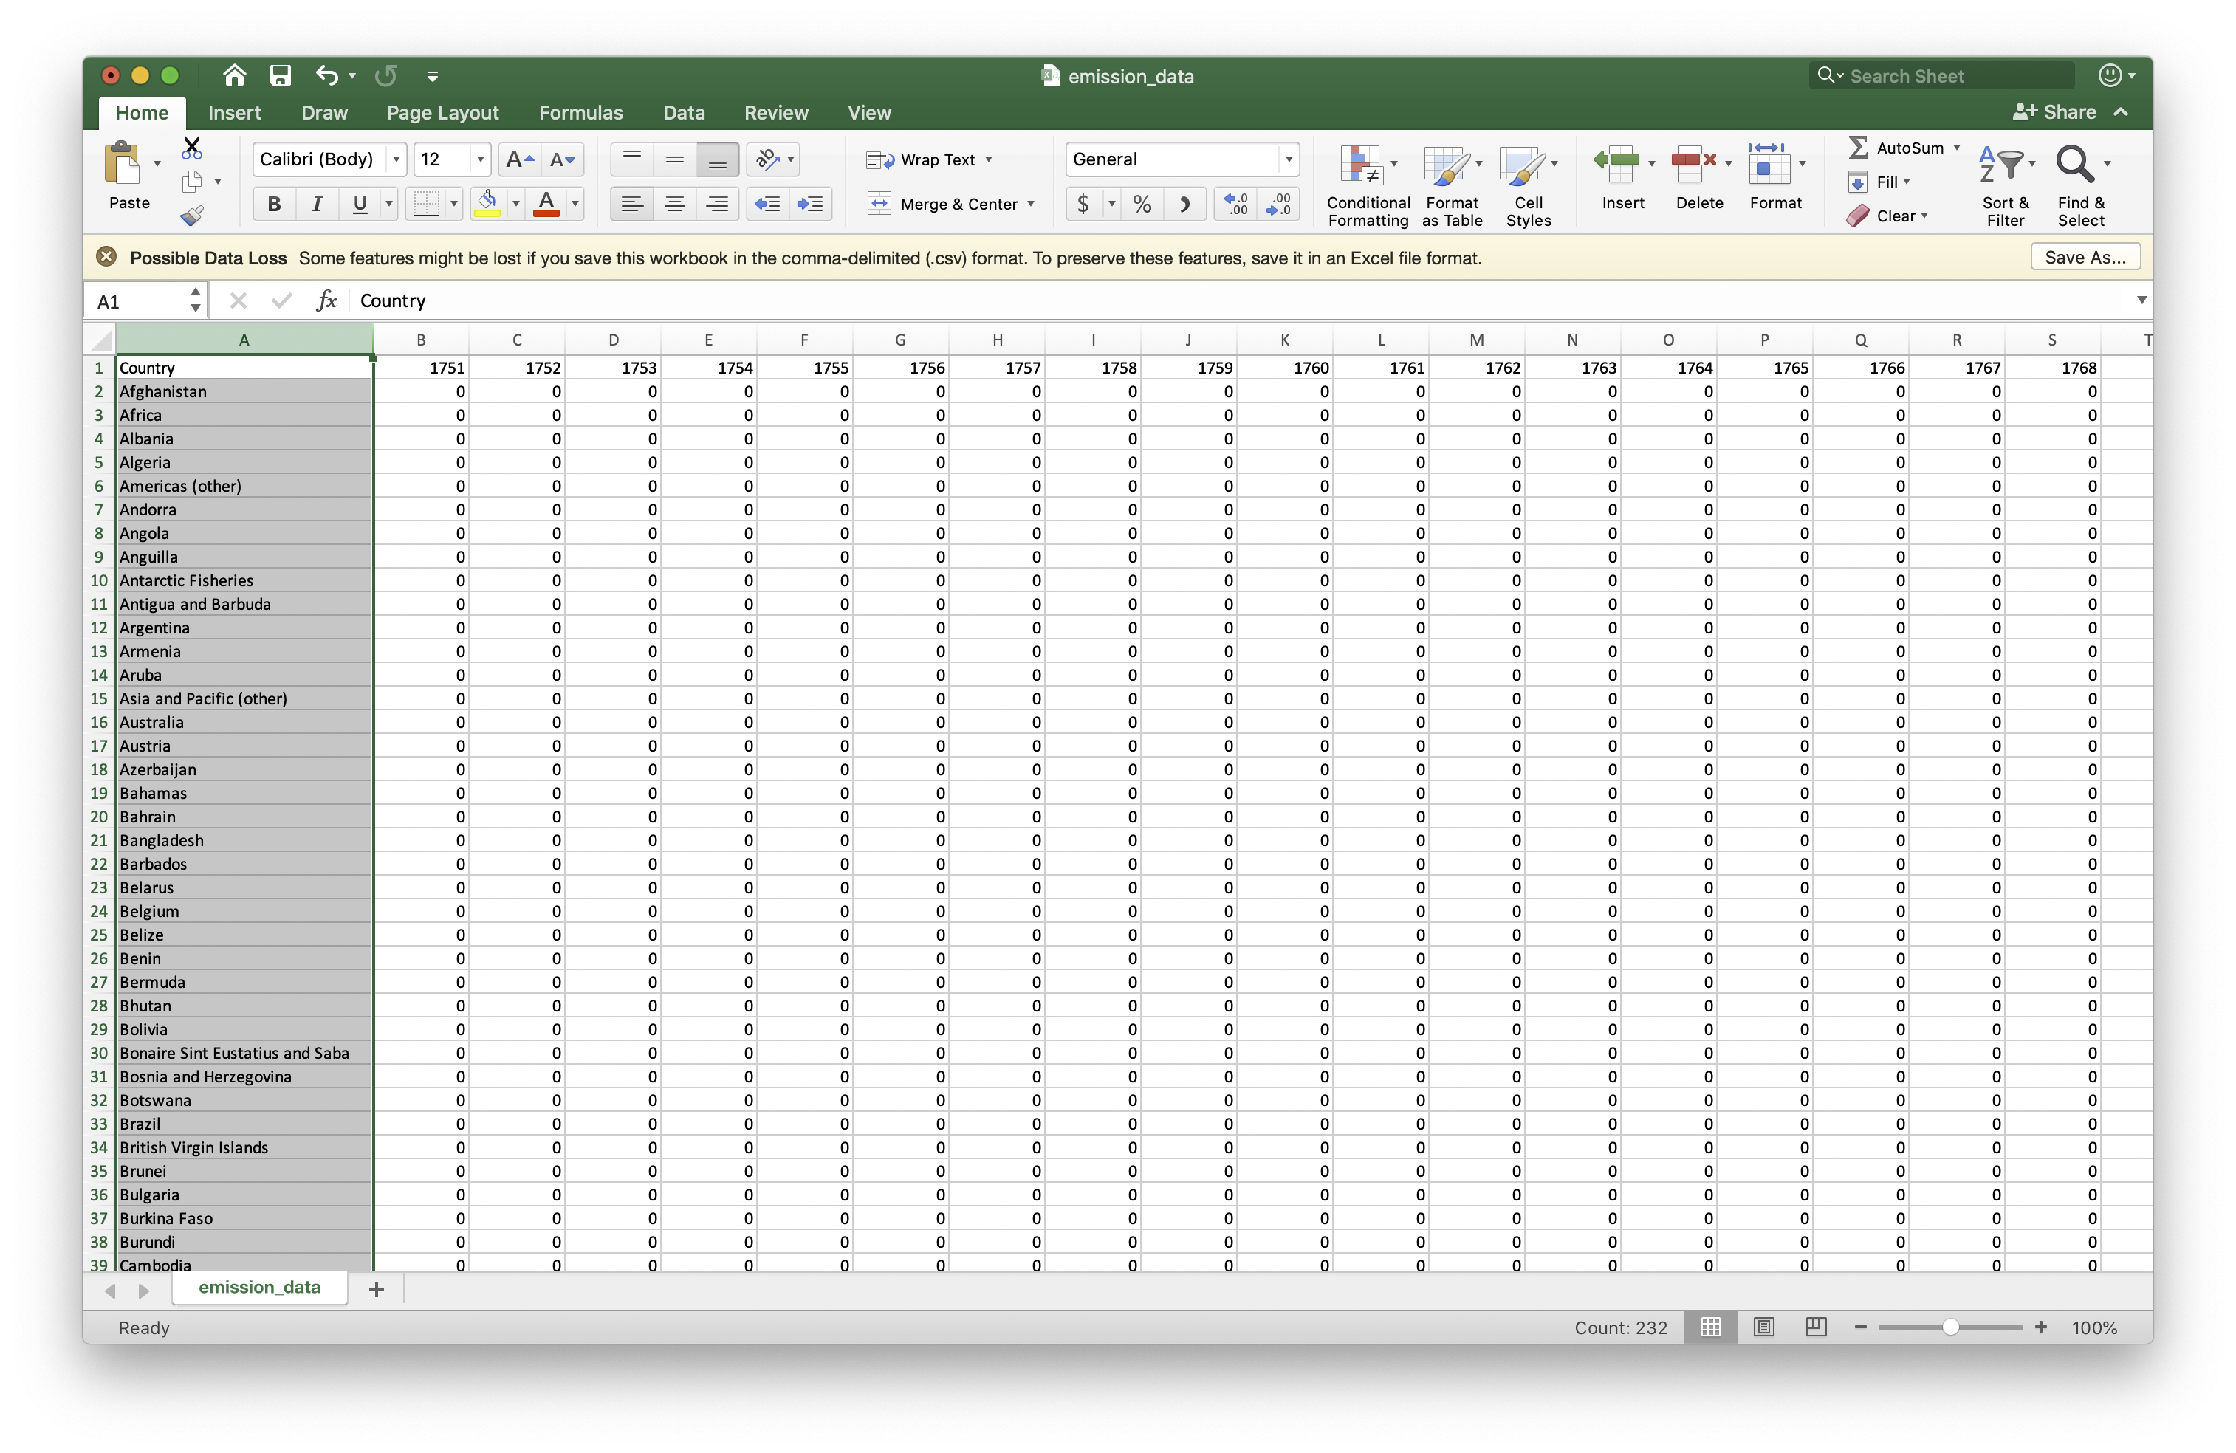
DATA PREVIEW
From Kaggle.com

Slide 7
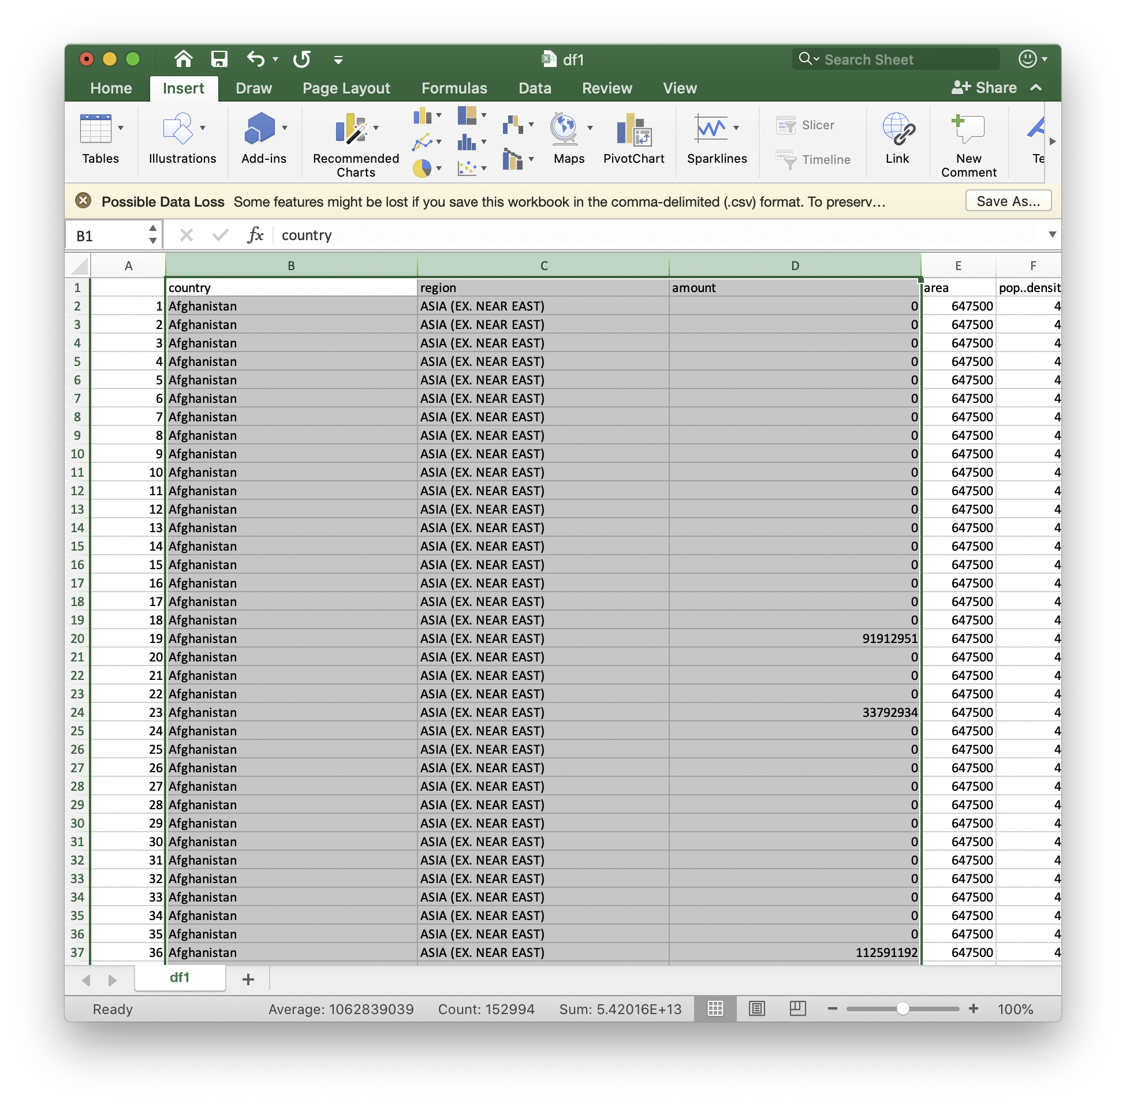
DATA MANIPULATION
1. Reformatting data frame
2. Join data frames

Slide 8
https://bariki.shinyapps.io/shinydashboard/

